Slide 1


Without using your notes, can you remember the 7 layers of the OSI Layer Model?

Slide 2

Recap
What layer would a router operate at?
What layer would a switch operate at?
What does the presentation layer do?
What does PAN stand for?

Slide 3

Learning Objectives
Describe the role of common network protocols and identify their OSI layer
Explain how data packets are structured and transmitted
Demonstrate understanding of packet switching, error detection, bandwidth and latency

Slide 4
Work with your partner/group to finish your slide on protocols from last lesson.
Ensure you include
-What it does
-Where it sits in the OSI Layer model
-An example in real life

Slide 5

Presentation Time

Slide 6
Peer Marking
We’re not grading each other — we’re giving professional-style feedback, just like colleagues do in industry. Our goal is to help each other improve, not to judge
❌ “That was confusing.”
✅ “Your explanation of POP was clear — you could make it even stronger by adding how it compares to IMAP

Slide 7

Protocol Match
As a class, can you match the protocols to the layers of the OSI model?
Notes:
Create protocol cards

Slide 8
Protocols are essentially specialist workers on a team
Each has a specific job at it’s layer, and they hand off data to the next person in line
Notes:
Create protocol cards

Slide 9
Web access
  DNS resolves the website name
2. HTTP/HTTPS sends a request using that IP
3. TCP manages reliable transmission
4. IP routes the packet to the correct destination using routing protocols (RIP/OSPF)
5. Ethernet/Wi-fi delivers the packets
Notes:
Create protocol cards

Slide 10
Email Transfer
  SMTP sends mail from sender to server
2. DNS uses MX records to find the destination mail server
4. Recipient retrieves mail via POP or IMAP
5. TCP/IP handle the transmission across the internet
Notes:
Create protocol cards

Slide 11
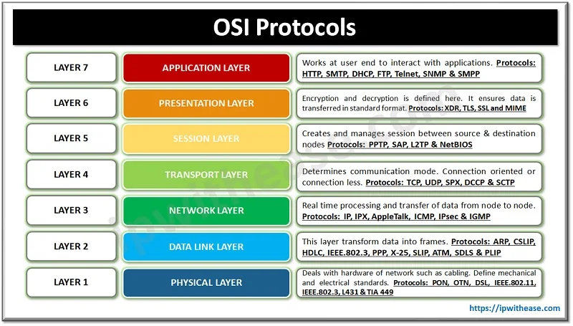
Notes:
Create protocol cards

Slide 12
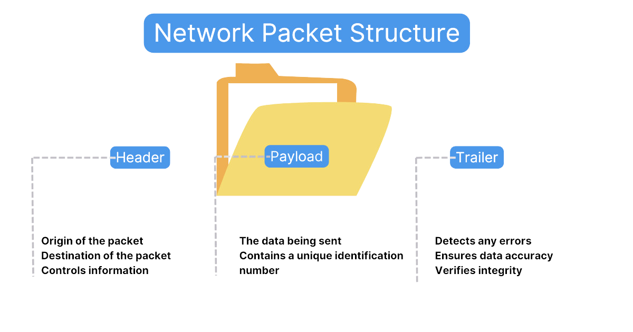
Data Packets
Notes:
Header - contains instructions about the data and has several parts
Payload - Body of data packet that contains the actual data that is being sent/received
Trailer - used to inform the receiving device that it is the end of the packet.
This is where the error checking happens

Slide 13
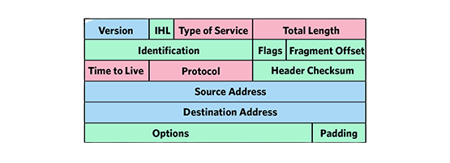
Data Packets
Notes:
Origin IP
Destination IP
Internet protocol
Size of the header and payload
Hops - number of routers will pass through
TTL - amount of time it exists within the network before being discarded
Flags - used to inform the router if the packet can be divided into datagrams
Checksum - error check
Packet number - the number of the packet where there is a sequence of packets

Slide 14
Packet Switching
This is where the data packet is divided into smaller data packets and transmitted individually instead of one large data packet. It is used to reduce the chances of lost packets
Packets are not necessarily routed along the same path in the network. This results in the packets arriving out of order. The destination reconstructs the packets in order
Notes:
CRC is in the data packet trailer and adds up all the 1's in the payload and stores the results as hexadecimal
On receiving the data packet, the receiving device will add up the number of ones in the payload and compare it with the hexadecimal value stored in the trailer.
When the two values match, there is confirmation that there was no error during transmission

Slide 15

What causes packet loss?
Notes:
What happens if a router loses a packet?
Network congestion
Faulty or overloaded hardware
Signal interferance
Buffer overflow
Packet corruption
Routing errors
Maximum transmission unit issues
Firewall/security filtering

Slide 16

What is meant by the term network latency?
What is meant by the term network bandwidth?
Notes:
The server stores data, apps and services
The waiter/kitchen providing what the customer asked for

Slide 17

Notes:
Create protocol cards

Slide 18

Cyclic Redundancy Check
Notes:
CRC is in the data packet trailer and adds up all the 1's in the payload and stores the results as hexadecimal
On receiving the data packet, the receiving device will add up the number of ones in the payload and compare it with the hexadecimal value stored in the trailer.
When the two values match, there is confirmation that there was no error during transmission

Slide 19
Task Brief
Create an infographic comparing the OSI model and the TCP/IP model
Show:
The layers in each model, side by side
Which layers are equivalent or combined
Common protocols that operate at each layer
How data changes state as it moves through layers
At least one visual link showing how the models interact in real world communication
Notes:
Directs traffic between LANs and the internet using an IP address
Like a traffic controller or a motorway junction deciding each road each packet should take

Slide 20

Which failure would cause the most chaos?

Slide 21

If you could only keep 3 network protocols, what would they be and why?

